Slide 1
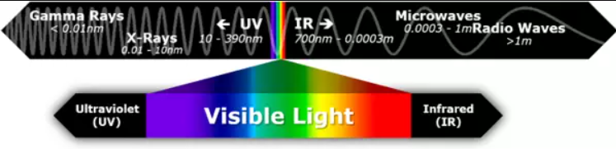
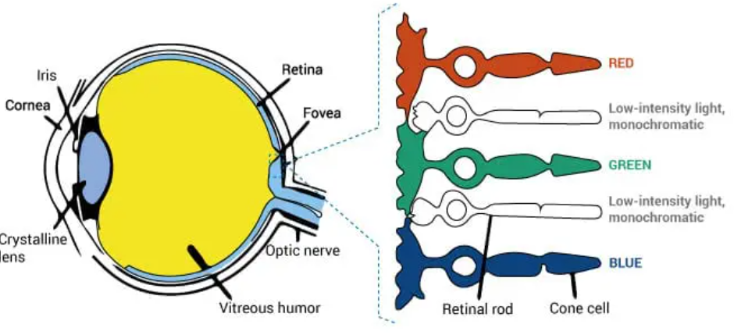

Slide 2
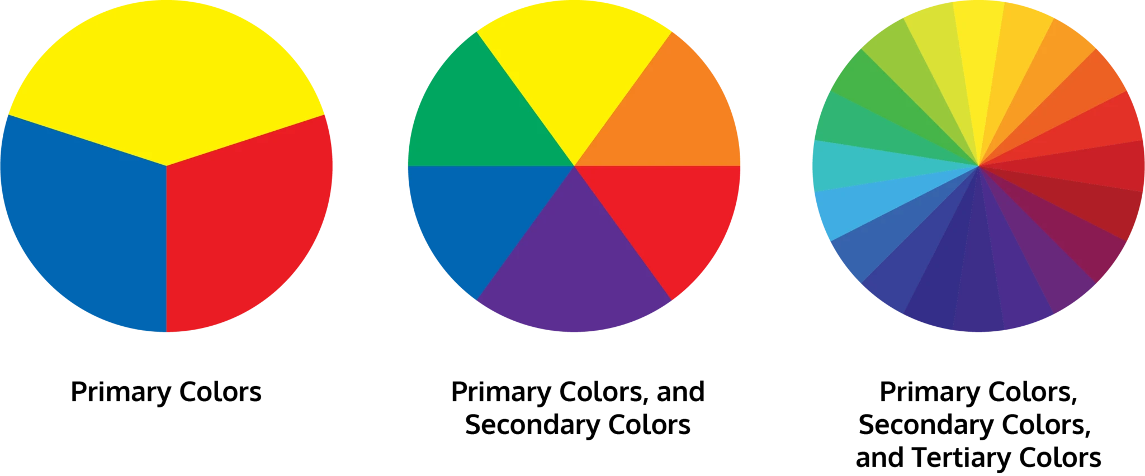
Primary Colors

Slide 3

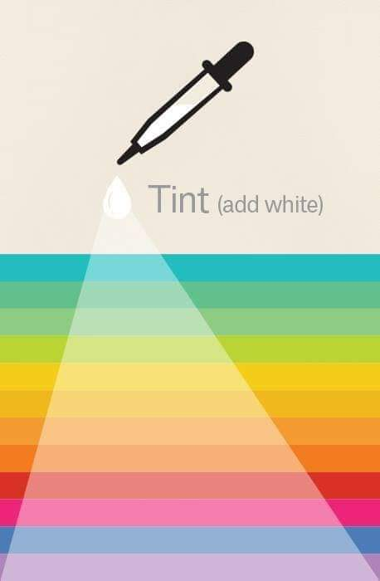
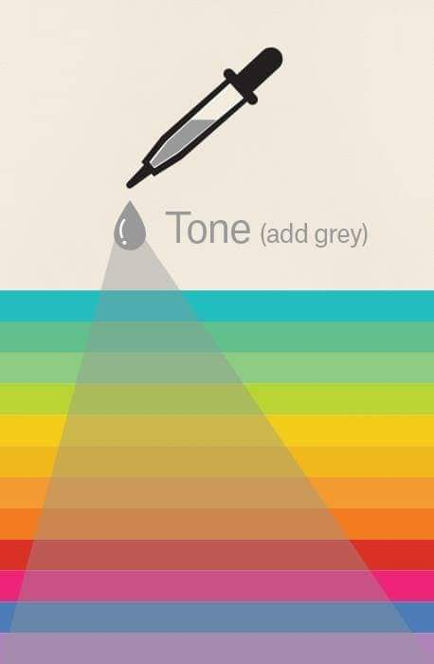

Slide 4
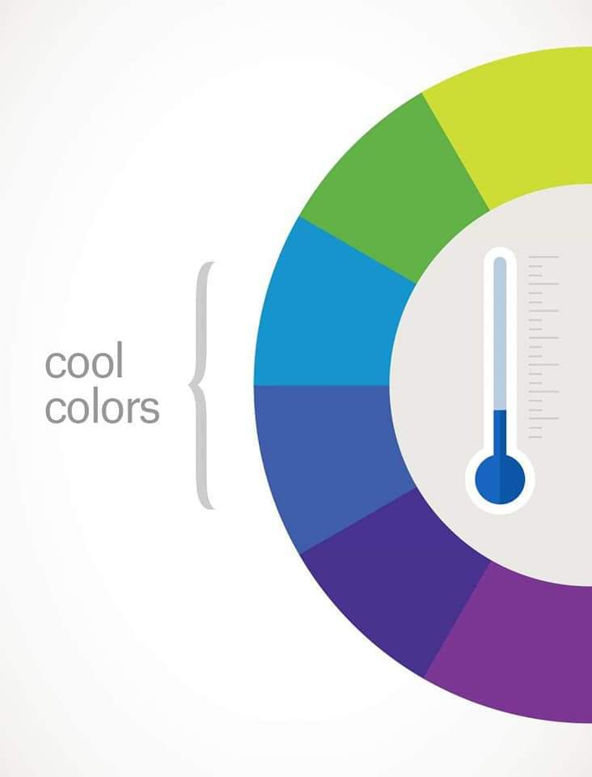
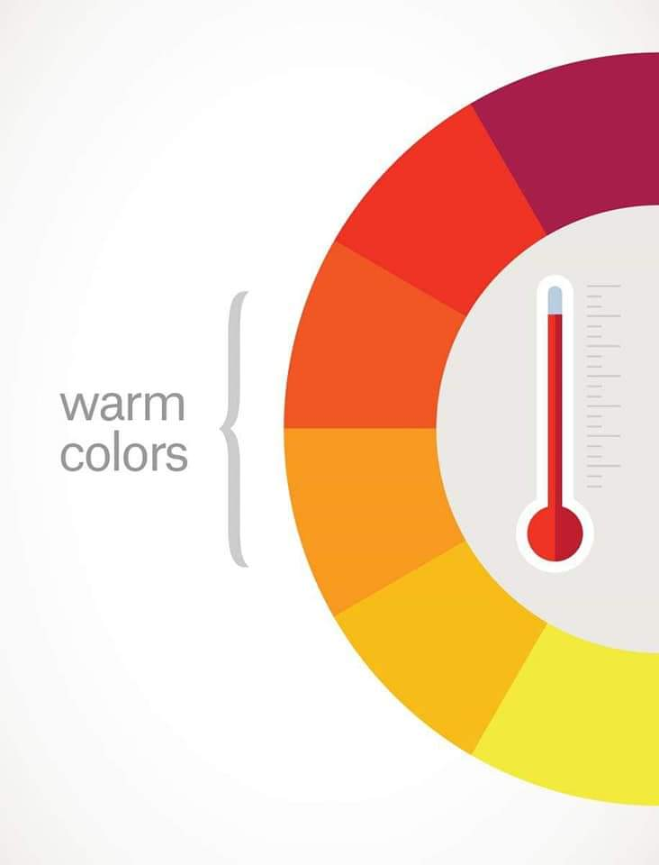
How colors are represented in terms of feeling/temperature.

Slide 5
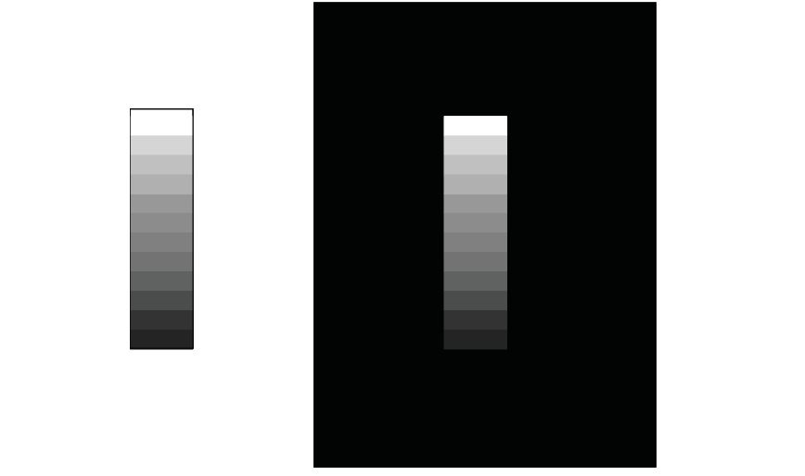

Slide 6


Slide 7
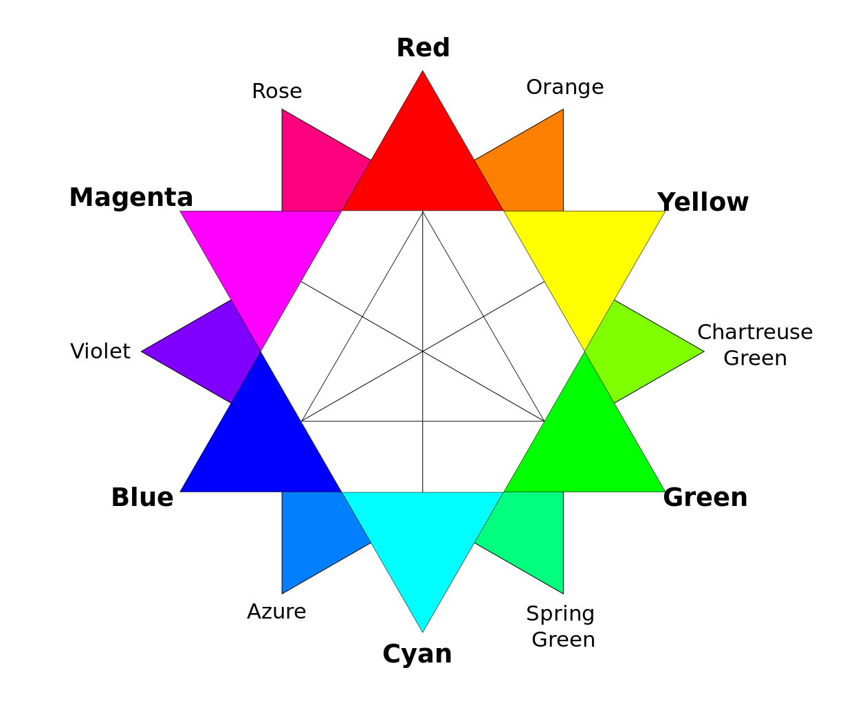
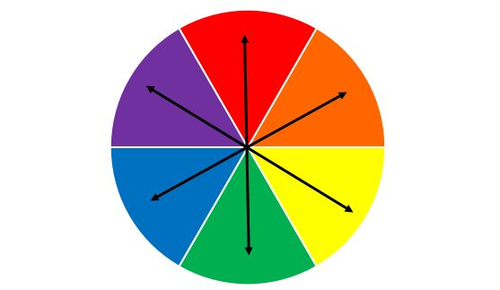
Complementary Colors
CMYK Wheel

Slide 8
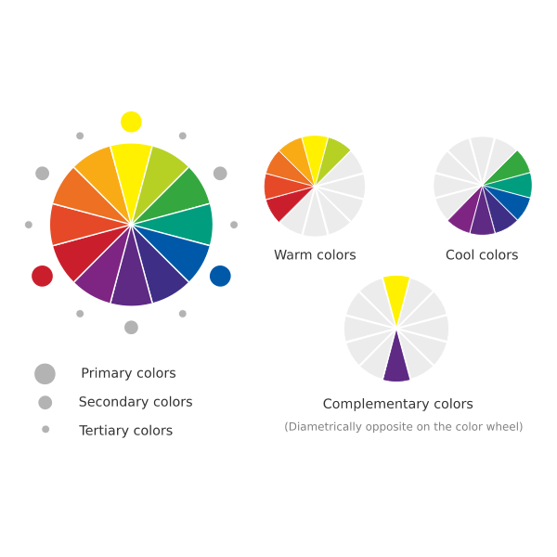
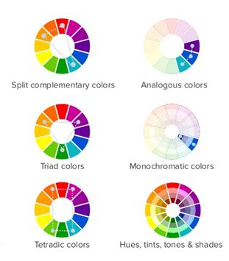
Notes:
Triad colors, split complementary and tetradic color

Slide 9
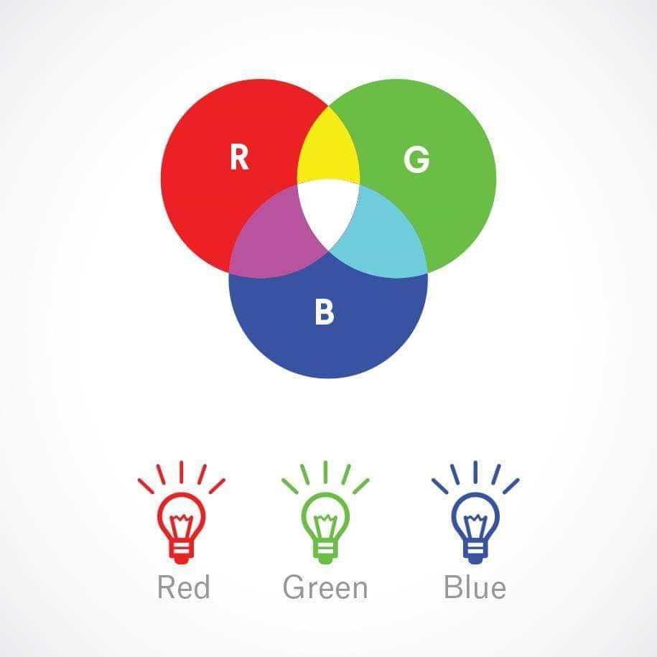
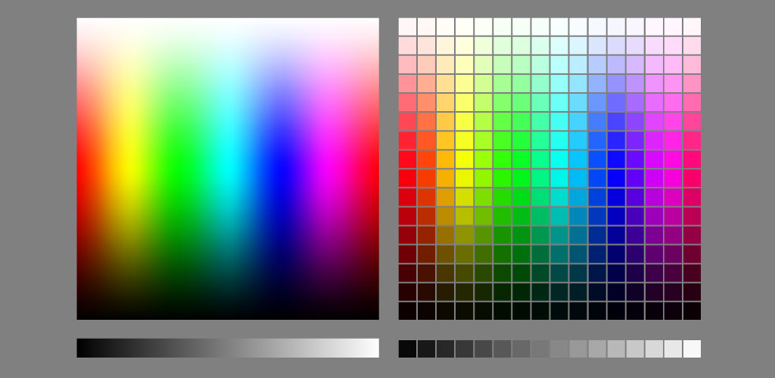
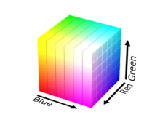
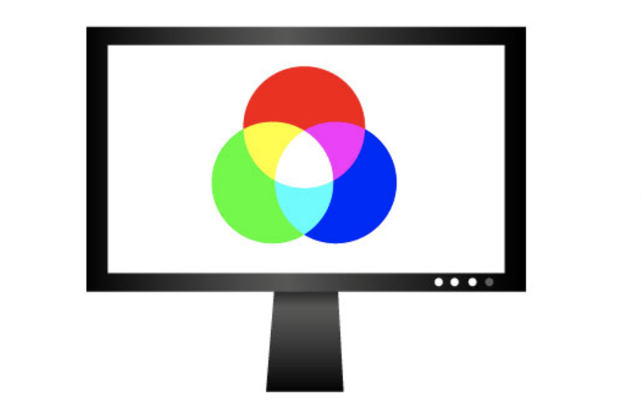
Color gument used for screens only
Also referred to as color pallet

Slide 10
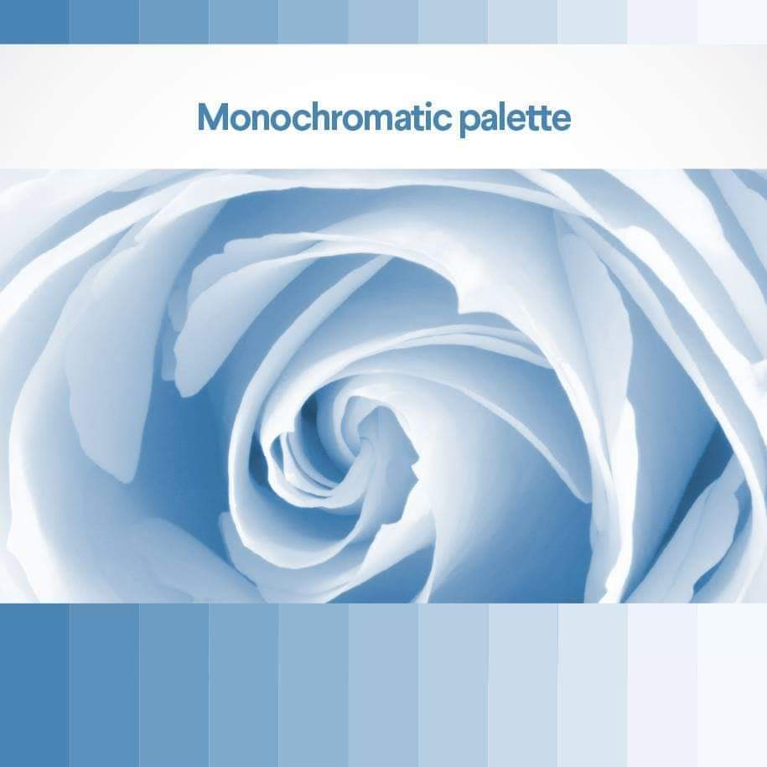
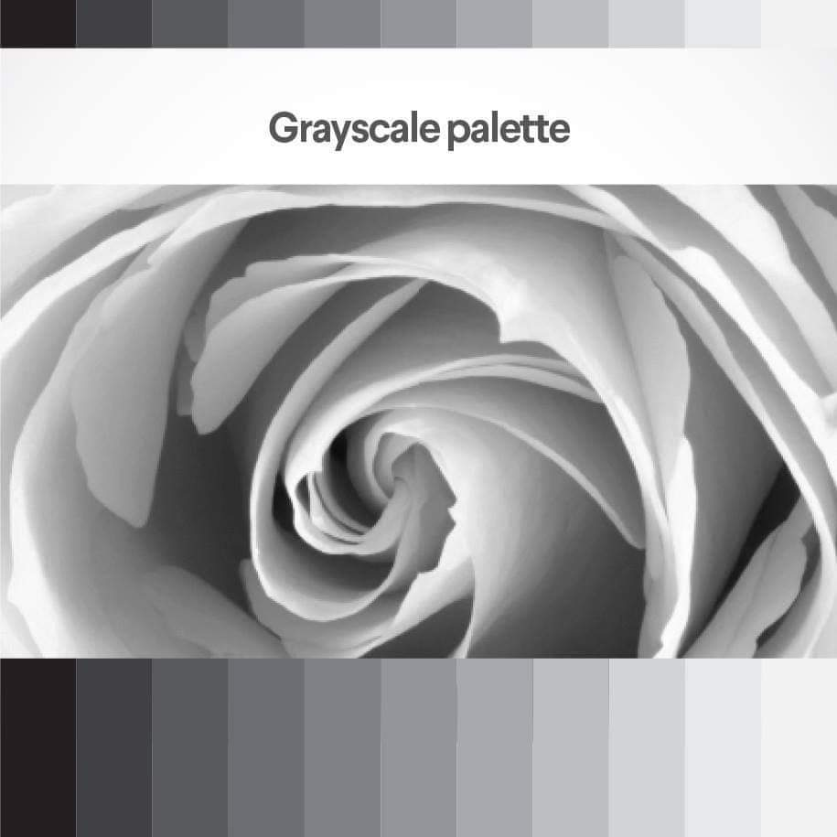
Gradients of a color from 100% and 10% white to 100% white and 10% of the color

Slide 11
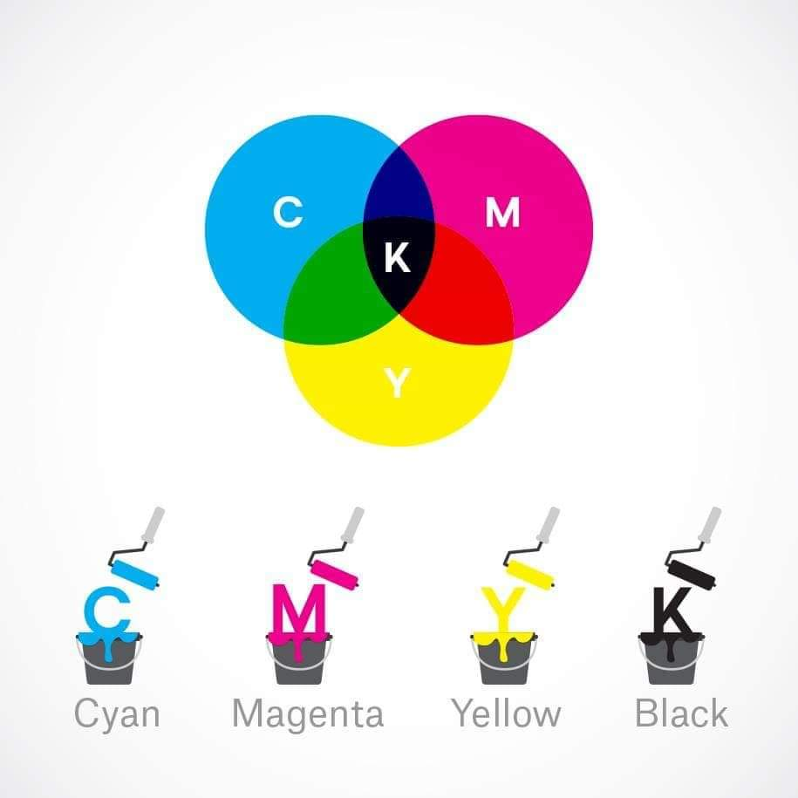
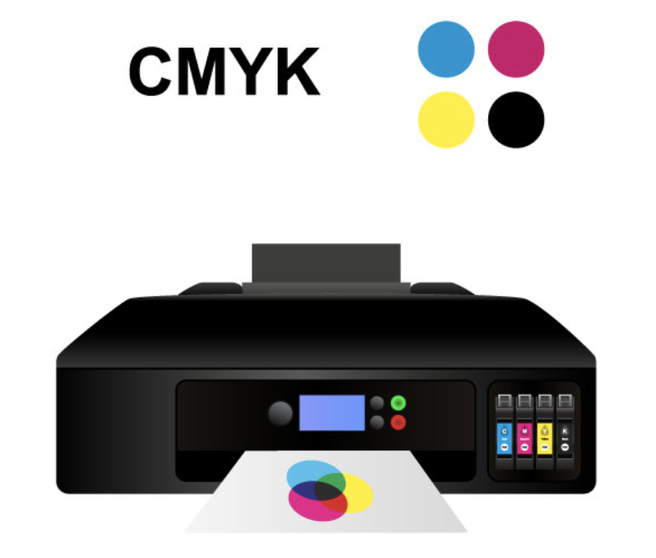
Color gument used for printing only

Slide 12
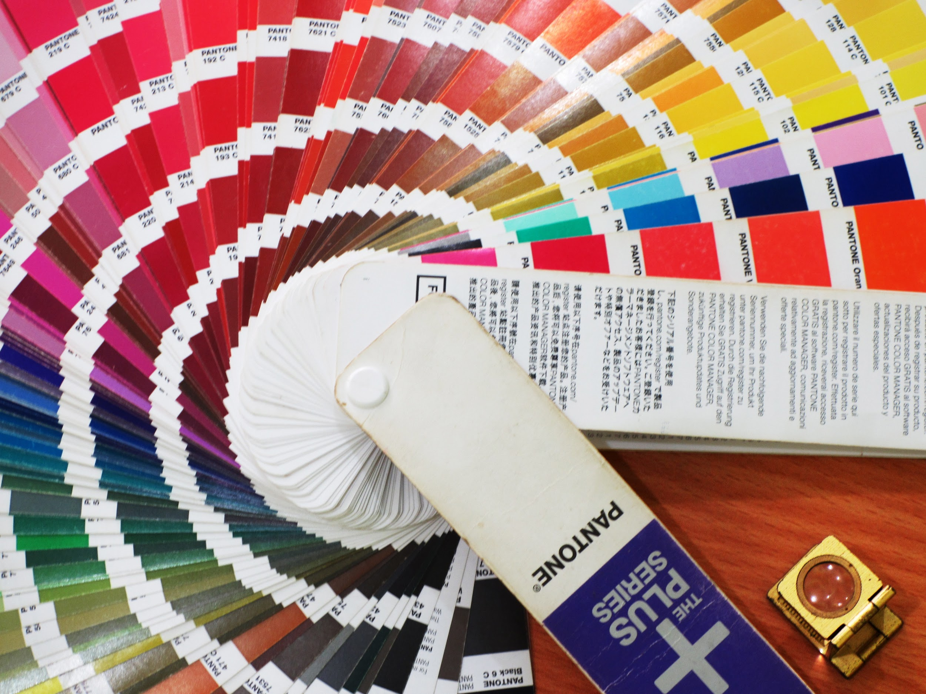
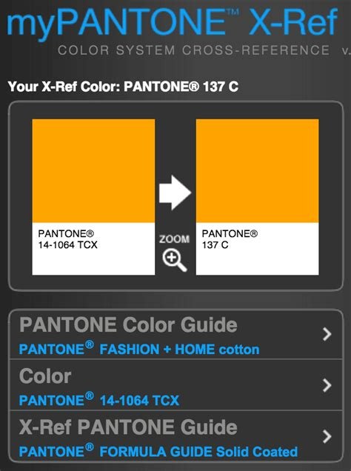
Pantone Colors
Pantone colors are the only color system that stays true across all media, print, paint and screens.

Slide 13
Vocabulary
Primary Colors: Yellow, blue and red
Secondary Colors: Orange, violet and green
Tertiary Colors: Combination of 2 secondary colors or a primary and a secondary color.
Tone: The amount of gray or black on a picture.
Tint: The amount of white in a picture.
Monochromatic: Color palette based on a single color, usually with different tint or tones.
Gray Scale: A pallet witch uses only black, white and shades of gray.
Analogous Colors: A pallet which uses 3 colors next to each other on the color wheel.
Complementary Colors: Colors across from each other on the color wheel.
Triad Color: Colors that form an equilateral triangle when connected by lines.
Quadratic Colors: 2 groups of complementary colors which are one color away from each other.
Warm Colors: One half of the color wheel from red to yellow-green, these colors are considered to be warm colors.
Cool Colors: One half of the color wheel from purple to blue-green, these color are considered to be cool colors.

Slide 14



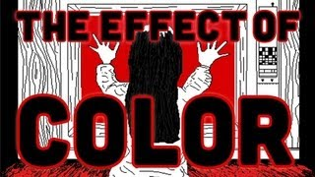
Video Resources

Slide 15
Are You Color Blind?
https://www.colorlitelens.com/ishihara-test

